Slide 1
ART & Activism
Dangerous Art
All art is political in the sense that all art takes place in the public arena and engages with an already existing ideology. Yet there are times when art becomes dangerously political for both the artist and the viewers who engage with that art. Think of Jacques-Louis David's involvement in the French Revolution—his individual investment in art following the bloodshed—and his imprisonment during the reign of terror. If it were not for certain sympathisers, David may well have ended up another victim of the guillotine. Goya is another example of an artist who fell foul of government power. There are instances in the 20th century when artists have faced down political power directly. Consider the photomontages of John Heartfield. Heartfield risked his life at times to produce covers for the magazine A/Z, which defied both Hitler and the Nazi Party.
In a time of globalization, populism, hypercapitalism, migration, War on Terror, and global warming, artistic engagement is vital. What is the role of art and activism in the polarized, populist society of the spectacle?

Slide 2
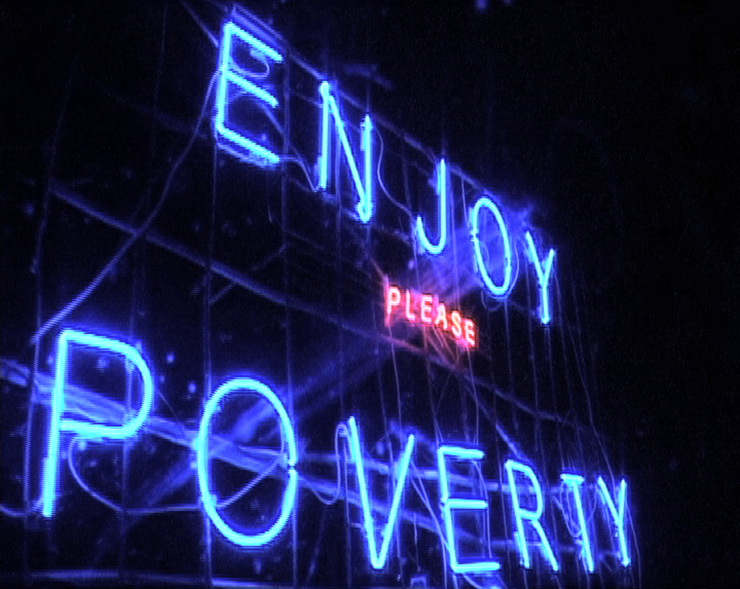
Renzo Martens' film Enjoy Poverty as a platform to explore how artists can stimulate the political consciousness of the consumers of tragedies that we ('Western' audiences) are. A few years ago, Martens went to the Democratic Republic of Congo to launch a two-year project that examined the exploitation of one of Africa's major exports: images of poverty and suffering. The artist traveled with a blue neon billboard that read ENJOY POVERTY and worked with Congolese photographers, teaching them how to sell images of suffering to Western media and aid agencies.
www.youtube.com/watch?v=yREqd8QYtsQ

Slide 3
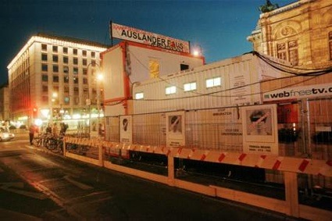
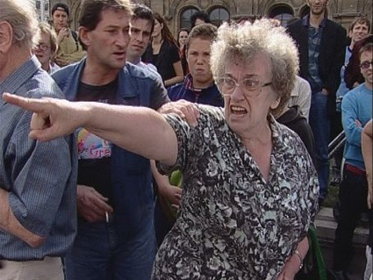
In 2000, shortly after Jörg Haider's far right party became part of the Austrian government, Christoph Schlingensief set up a camp for asylum seekers in a shipping container outside the Vienna Opera House. Twelve asylum seekers lived in the container for 6 days, their lives streamed over the web in a kind of Big Brother show, and the audience were invited to vote their least favourite players to exit the container and be deported to their native country. Decorated with a banner saying Ausländer Raus! ('Foreigners out!'), the container became a flashpoint in Austria's national and racial debate. One of the outcome of the work is that, at the end of the show, antifascist action groups stormed the container and freed the immigrants (who were actually actors.)

Slide 4
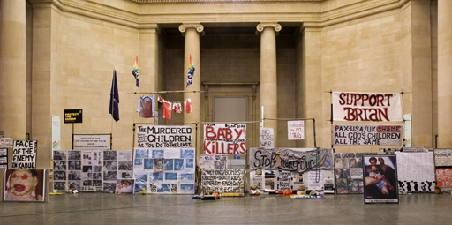
Mark Wallinger recreated peace campaigner Brian Haw’s Parliament Square protest. Running along the full length of the Duveen Galleries, State Britain consists of a meticulous reconstruction of over 600 weather-beaten banners, photographs, peace flags and messages from well-wishers that have been amassed by Haw over the past five years.
Faithful in every detail, each section of Brian Haw’s peace camp from the makeshift tarpaulin shelter and tea-making area to the profusion of hand-painted placards and teddy bears wearing peace-slogan t-shirts has been painstakingly sourced and replicated for the display.
Fabrication of State Britain
Brian Haw began his protest against the economic sanction in Iraq in June 2001, and has remained opposite the Palace of Westminster ever since. On 23 May 2006, following the passing by Parliament of the ‘Serious Organised Crime and Police Act’ prohibiting unauthorised demonstrations within a one kilometre radius of Parliament Square, the majority of Haw’s protest was removed. Taken literally, the edge of this exclusion zone bisects Tate Britain. Wallinger has marked a line on the floor of the galleries throughout the building, positioning State Britain half inside and half outside the border.
In bringing a reconstruction of Haw’s protest before curtailment back into the public domain, Wallinger raises challenging questions about issues of freedom of expression and the erosion of civil liberties in Britain today.

Slide 5
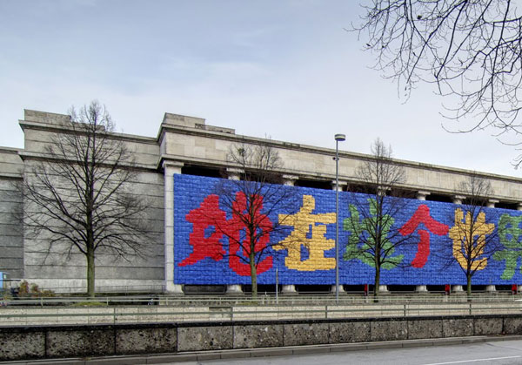
Ai Weiwei
The Chinese artist, Ai Weiwei, offers is an important contemporary example. Recently, Weiwei was arrested in China following a crack down by the government on so-called “political dissidents”
Ai Weiwei, Remembering, backpacks, Haus der Kunst,* Munich, 2009 The characters spell out the sentence ‘She lived happily for seven years in this world’. This is a quote from a mother whose child died in the Sichuan earthquake. Ai Weiwei said:
“The idea to use backpacks came from my visit to Sichuan after the earthquake in May 2008. During the earthquake many schools collapsed. Thousands of young students lost their lives, and you could see bags and study material everywhere. Then you realize individual life, media, and the lives of the students are serving very different purposes. The lives of the students disappeared within the state propaganda, and very soon everybody will forget everything.”

Slide 6
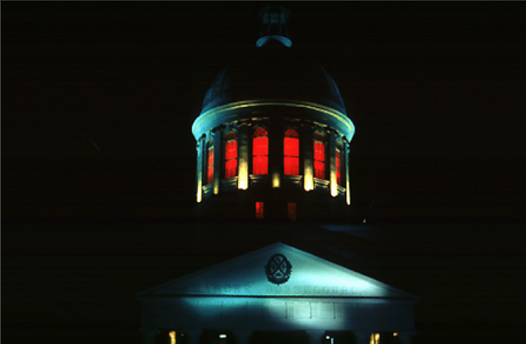
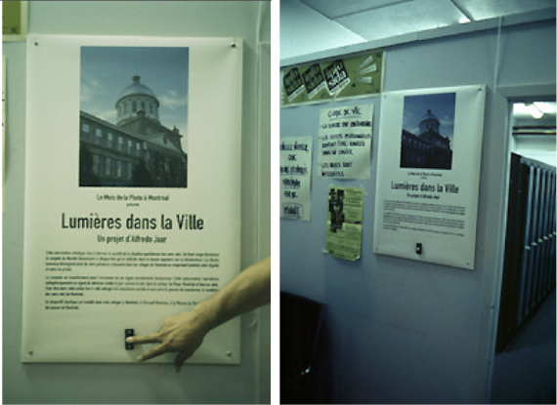
Alfredo Jaar's Lights in the City an example of art work that fuels a debate in society and unsettles without resorting to easy provocation.
The artist installed red light on the Copula of the Marche Bonsecours, a landmark monument in the centre of Montreal. The lights were connected to homeless shelters located 500 yards from the building. When a homeless person entered one of the shelters, they could press the button that would make the top of the building glow red.
Eventually all the shelters for homeless people in Montreal could be wired and connected to the Cupola. This way, a major landmark and historical monument in the city would be acting as a non-stop lighthouse, producing endless, painful distress signals to society. With enough media coverage and public outrage and support triggered by these ongoing distress signals, homelessness could be completely eradicated from Montreal,.
The strategy worked so well that the commissioning authority ended the intervention.

