Slide 1
Humour in Contemporary art
Key to understanding the humorous tactics of contemporary artists are the strategies of Surrealism, Dada, and Fluxus, as well as the satirical precedents set by artists like Francisco Goya, George Grosz, and John Heartfield, who were equally important as social critics as well as artists. Surrealists interwove puns, bawdy jokes, and punch line–esque titles into their work, and the relationship between text and image was central to their use of humor. Dada continued to fine tune these methods with its own particular flavor and tone. Marcel Duchamp famously championed the idea that art could be play as much as work and could strive to make people laugh. Satire was a key strategy in art between the two world wars and created a bridge between the cartoon or caricature and fine art traditions. https://www.youtube.com/watch?v=cyVrvUyySTU

Slide 2
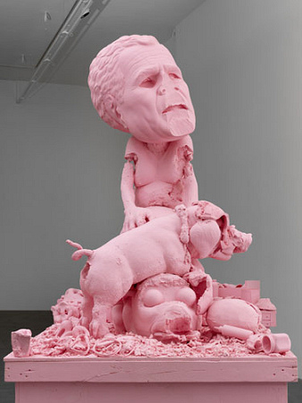
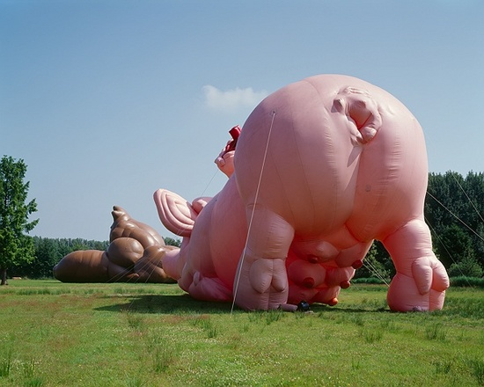
Paul McCarthy http://www.youtube.com/watch?v=ozubKHdprMI
Paul McCarthy was born in 1945 in Salt Lake City.). Paul McCarthy’s video-taped performances and provocative multimedia installations lampoon polite society, ridicule authority, and bombard the viewer with a sensory overload, of often sexually-tinged, violent imagery.

Slide 3
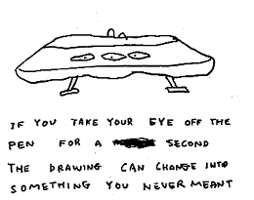
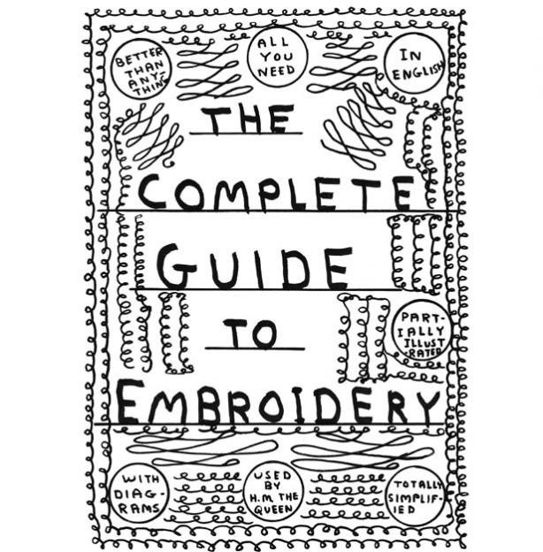
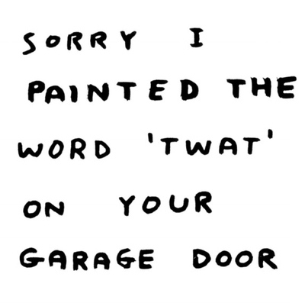
David Shrigley
http://www.youtube.com/watch?feature=player_detailpage&v=nkCPVc5YS98
http://www.youtube.com/watch?v=PvjGl6HhxgU

Slide 4
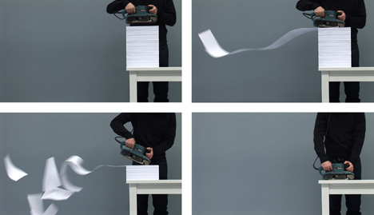
Harrison & Wood http://www.youtube.com/watch?v=eS50mYKCL_M

Slide 5

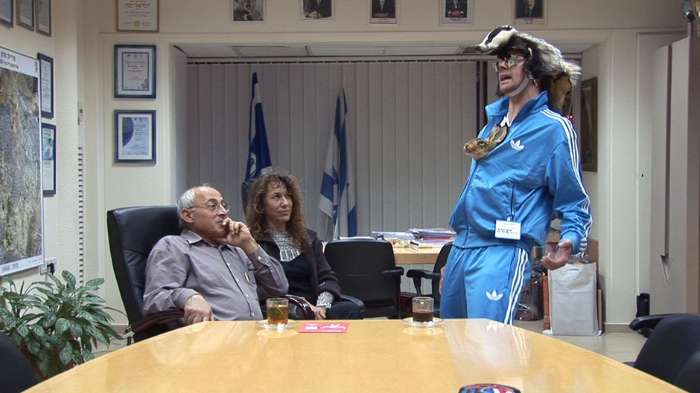
Marcus Coates http://www.youtube.com/watch?v=LErNGrBC-Bw http://www.youtube.com/watch?v=BfBgWtAIbRc

Slide 6
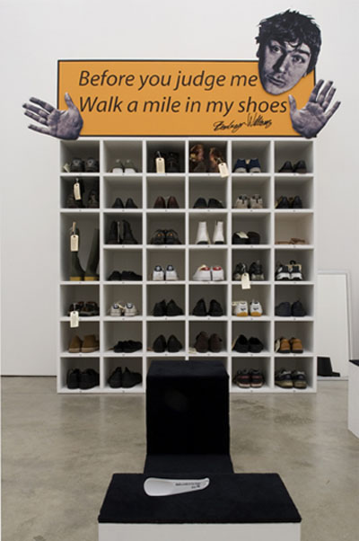
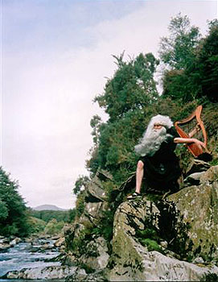
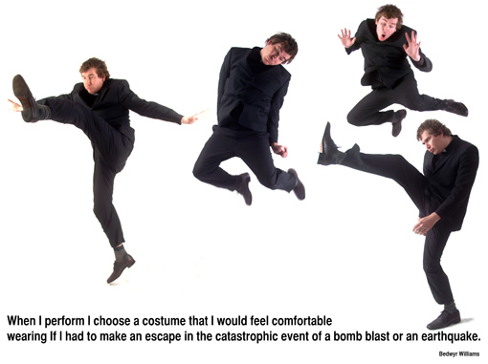
Bedwyr Williams http://www.youtube.com/watch?v=Bu-ZENHW9Oc http://www.youtube.com/watch?v=P6gKCIvJwwQ
Bard attitude
Walk a mile in my shoes

Slide 7
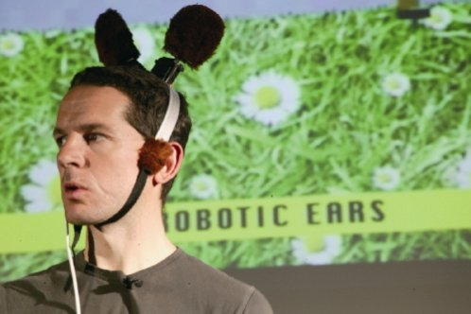
Paul Granjon
http://www.youtube.com/watch?v=jUYqEBxj9Qc

Slide 8
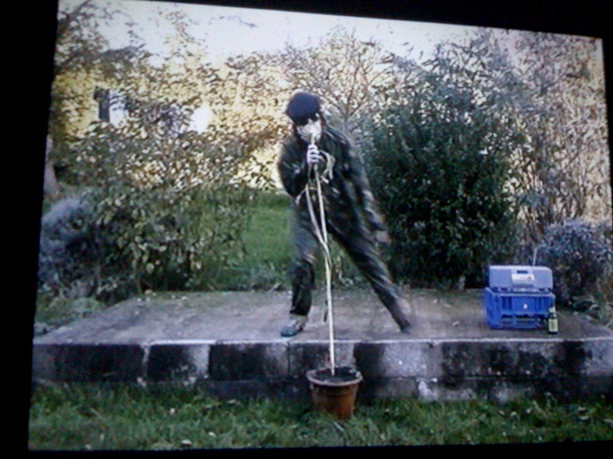
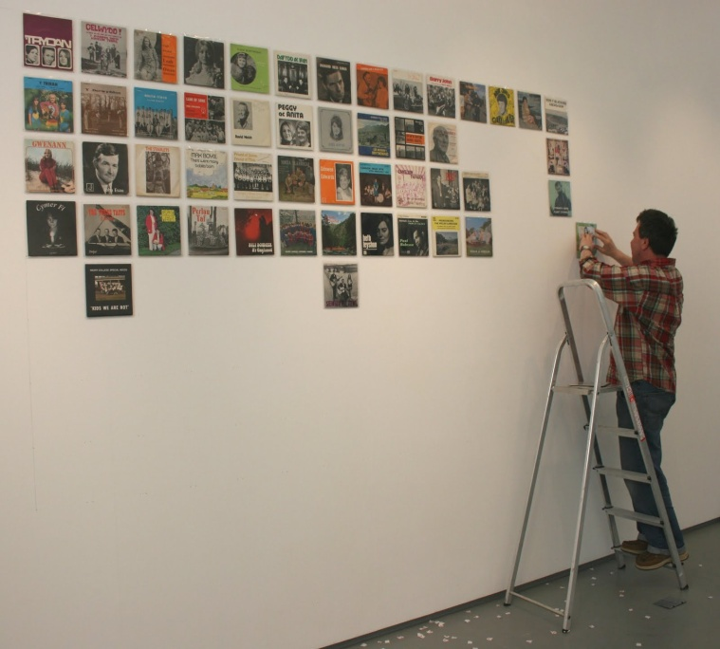
Peter Finnemore

Slide 9
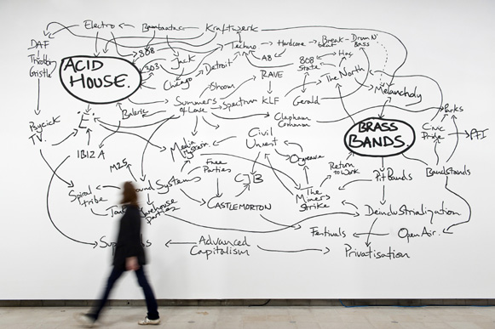

Jeremy Deller http://www.youtube.com/watch?v=gBJxMQGYXM4

Slide 10
http://blog.frieze.com/art-humour/
http://www.artvehicle.com/feature/27
http://www.youtube.com/watch?feature=player_detailpage&v=BfBgWtAIbRc
http://www.youtube.com/watch?v=cyVrvUyySTU
Further reading
Jennifer Higgie, ed. The Artist’s Joke (Cambridge, MA: Mit Press & London: Whitechapel, 2007),

