Slide 1
Memory in Contemporary Art

Slide 2
In Search of Lost Time
, by the French novelist Marcel Proust in 1909–1922, is one of the most reoccurring of influences on contemporary art. Proust mentions more than one hundred artists—from Bellini to Whistler—in the novel, referencing a great many of their works.

Slide 3
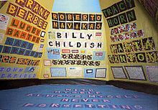
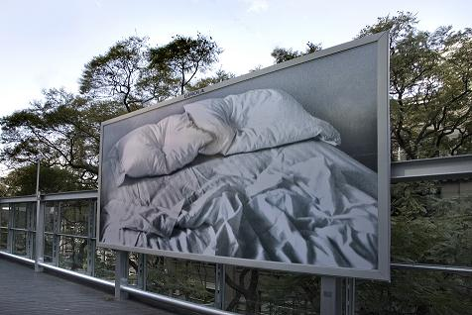
Autobiography : the externalisation of personal memory
Tracey Emmin
https://www.youtube.com/watch?v=Kg5ad44knPA
Felix Gonzales- Torres
https://www.youtube.com/watch?v=37bSb-aQ4BM

Slide 4
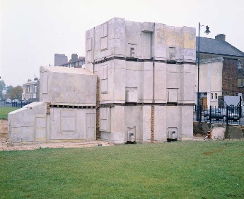
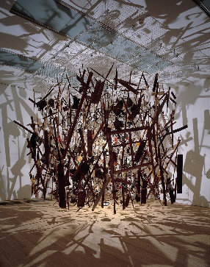
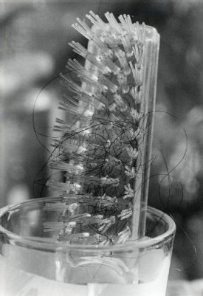
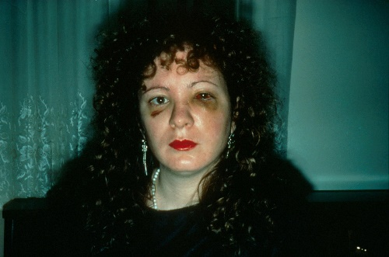
Traces anchoring memory through an indexical relationship with subject
Rachel Whiteread
https://www.youtube.com/watch?v=Tz-EqD-j3lI
Cornelia Parker
https://www.youtube.com/watch?v=cuAF55BN-Ak
Miyako ishiuchi –
https://www.youtube.com/watch?v=qopziSZ-z2A
‘mothers aging body’
Nan goldin – momento mori –
the ballad of sexual dependency https://www.youtube.com/watch?v=2B6nMlajUqU

Slide 5
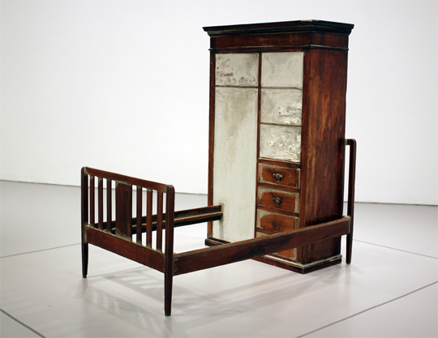
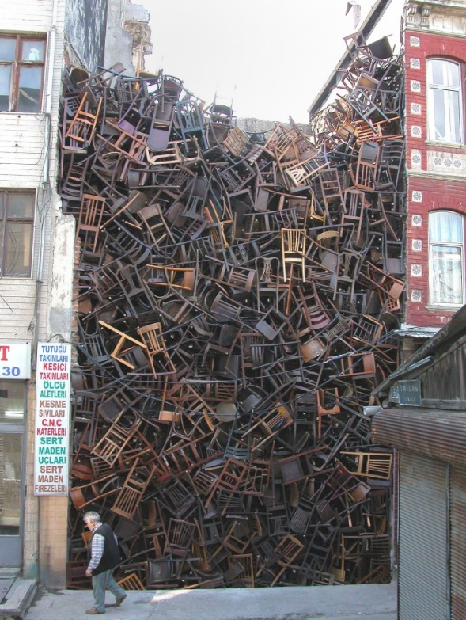
The reassembling of history
Doris Salcedo the work derives from personal memories of dead and the disappeared collected first hand from the politically oppressed in Columbia https://www.youtube.com/watch?v=TOpEO8kq0uE

Slide 6
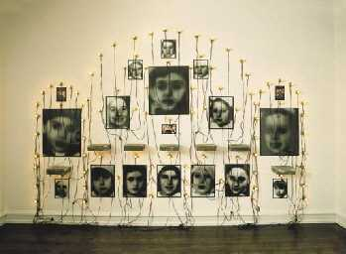
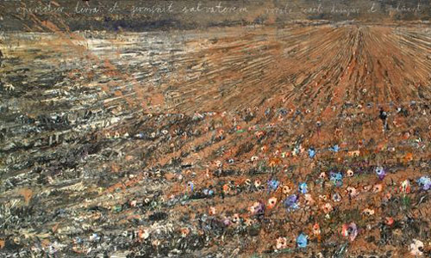
Post memory secondary memory ,constructed by the next generation
Christian Boltanski https://www.youtube.com/watch?v=R2cIp6iAlv8 https://www.youtube.com/watch?v=i8IbN7HNIhM&index=2&list=PLd9qNdYzVLt9jCG5t7Lh0gGGxZgb_uLZR
Anselm Kiefer https://www.youtube.com/watch?v=-OJNMyQhF4A fictive biographies archival data –personal possessions- questioning fiction and authenticity

Slide 7
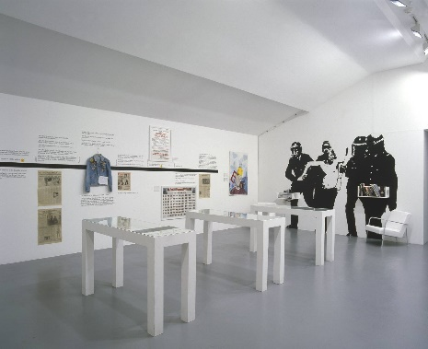
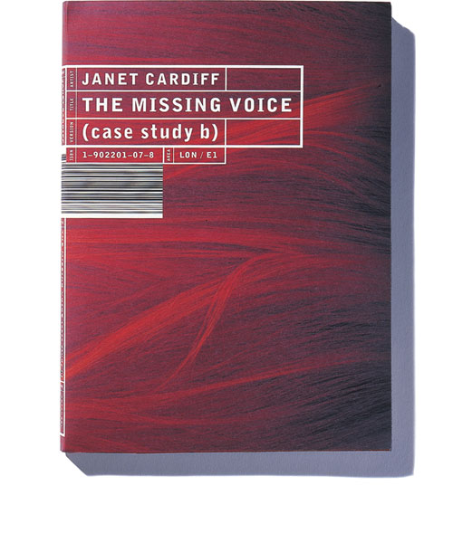
Enactments – re-enactments- memorial
Jeremy Deller –the battle of orgreave2001 http://www.jeremydeller.org/FolkArchive/FolkArchive.php
Janet Cardiff –the missing voice
Janet Cardiff's The Missing Voice (Case Study B) is part walking tour, part historical account, and part stream-of-consciousness narration leading you on a disorienting journey through the inner cityscape of East London. The walk lasts some 45 minutes, starting at the Whitechapel Library, where upon receiving headphones and a disc player, you follow the instructions from the narrator on the disc. The voice-over guides you to the crime section of the library, asks you to read excerpts from books, and leads you out of the library and onto the street. There, you follow instructions that take you through narrow alleyways into Brick Lane, past the old Jewish quarter into Spitalfields, and after pausing at the garden steps of a church, drops you off at the Liverpool Street tube station, where the piece ends; leaving you to puzzle your way back to the library, where the piece started. https://www.youtube.com/watch?v=rLoayWxaQ5g

Slide 8
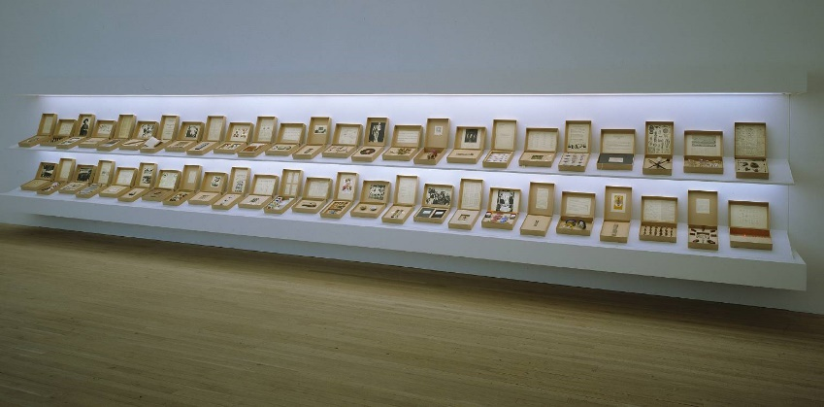
The ordering of knowledge – Archiving
Susan Hiller-from the Freud museum http://www.tate.org.uk/art/artworks/hiller-from-the-freud-museum-t07438
Mark Dion Tate Thames dig http://www.tate.org.uk/art/artworks/dion-tate-thames-dig-t07669 https://www.youtube.com/watch?v=8-Nzo0foijI

Slide 9
http://books.google.co.uk/books?hl=en&lr=&id=3fzIglPkA3UC&oi=fnd&pg=PP6&dq=memory+in+contemporary+art&ots=-
TFXycIp8w&sig=V6x2GzwKu3B0mDKPkKcQRdn3Z24#v=onepage&q=memory%20in%20contemporary%20art&f=false http://www.amazon.co.uk/The-Poetics-Space-Gaston-Bachelard/dp/0807064734 http://www.amazon.co.uk/Memory-Documents-Contemporary-Art-Farr/dp/0854882049/ref=sr_1_1?s=books&ie=UTF8&qid=1417000912&sr=1-1&keywords=documents+of+contemporary+art+memory

